Slide 1

Smart Device Usage Analysis: Understanding User Behavior and Trends

Slide 2
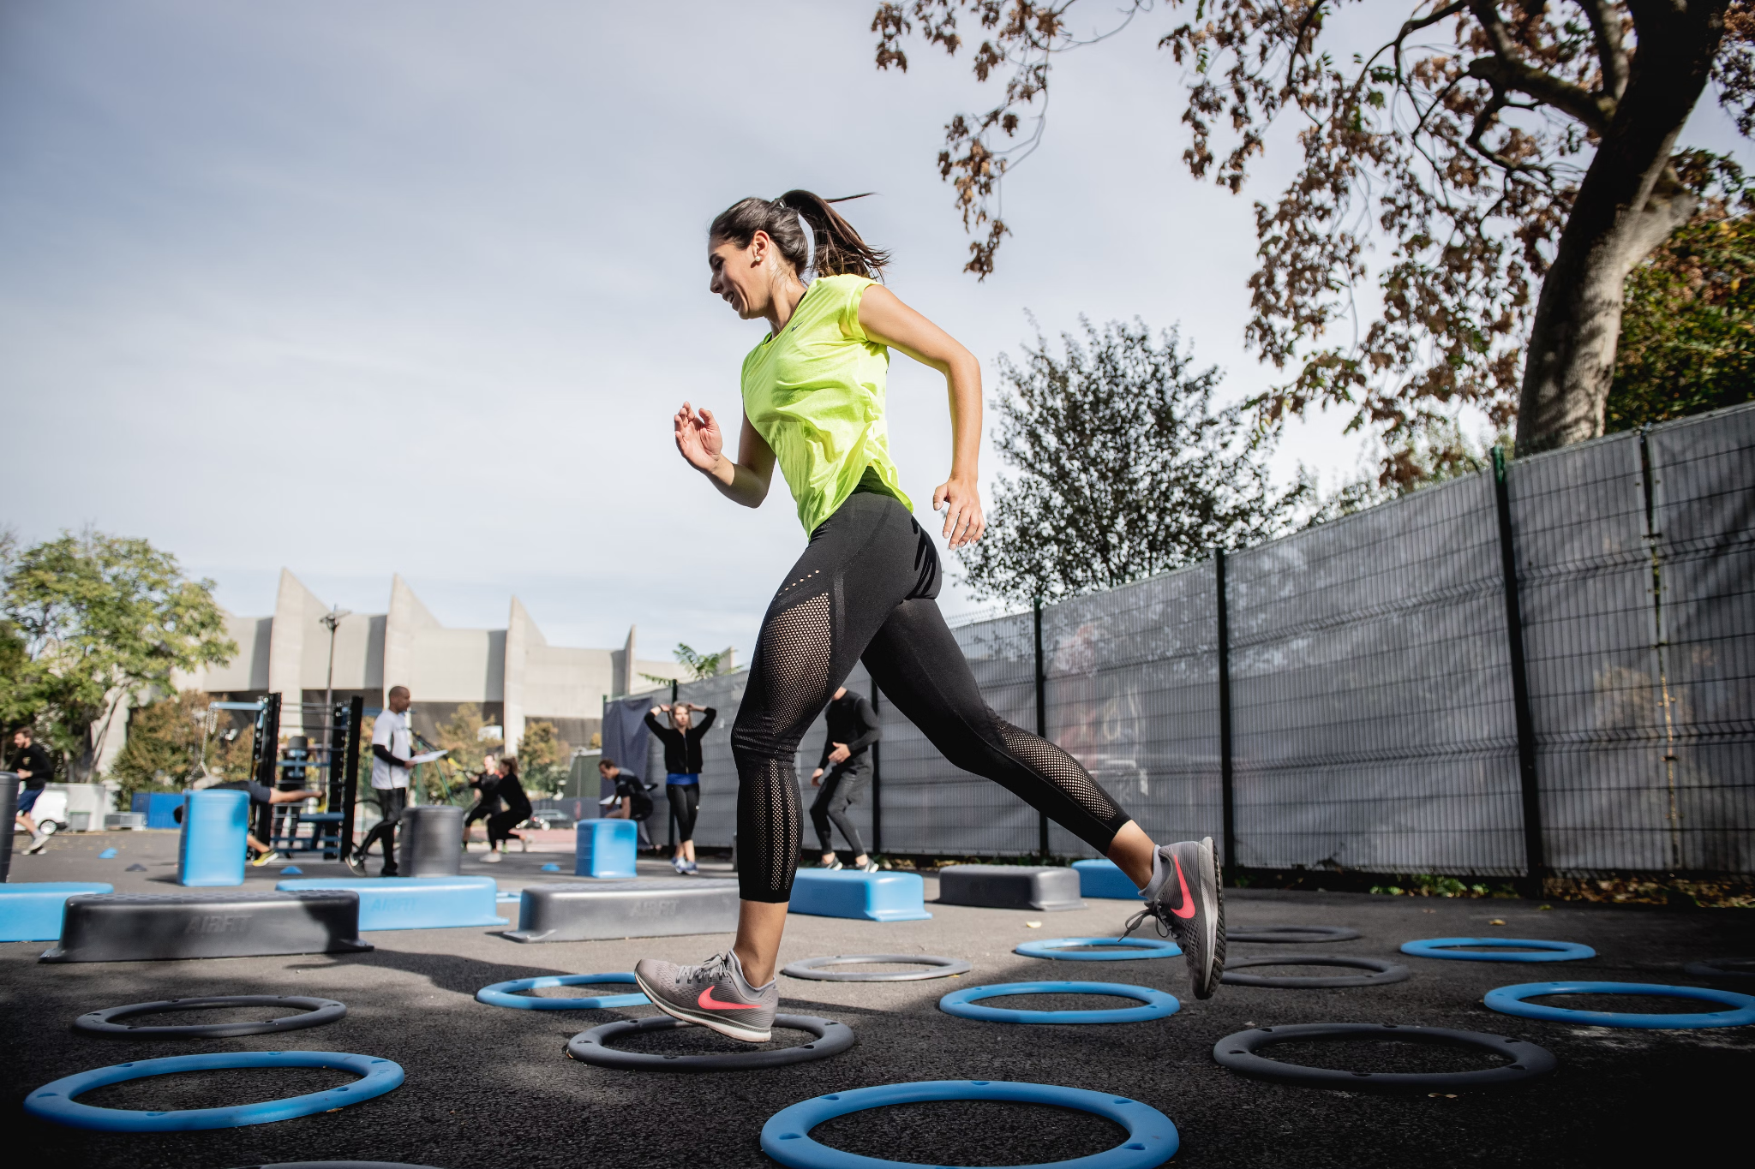
What is the goal of this analysis?
Develop better understanding of customer behaviour and health-related smart device usage trends
Customized marketing and personalized communication to acquire new customers and retain existing ones

Slide 3

Understanding Customer Insights
Usage Patterns and Customer Segmentation
How do our users use their devices?
What are observable trends?
How can we adapt our strategies and user experience accordingly?

Slide 4
Data Source Overview
Dataset: "FitBit Fitness Tracker Data"
Source: Möbius on Kaggle
License: CC0
Data: Minute-level outputs of activity, heart rate, sleep over 31 days
Users: 30 Fitbit users
Metrics:
Steps taken
Activity intensity
Calorie expenditure
Sleep
Etc.
Applicability:
Insights are most relevant to Bellabeat Time users

Slide 5
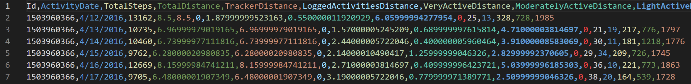
Workflow: Data Assessment and Cleaning
Assess data structure
Analyze data distribution
Clean missing data & outliers

Slide 6
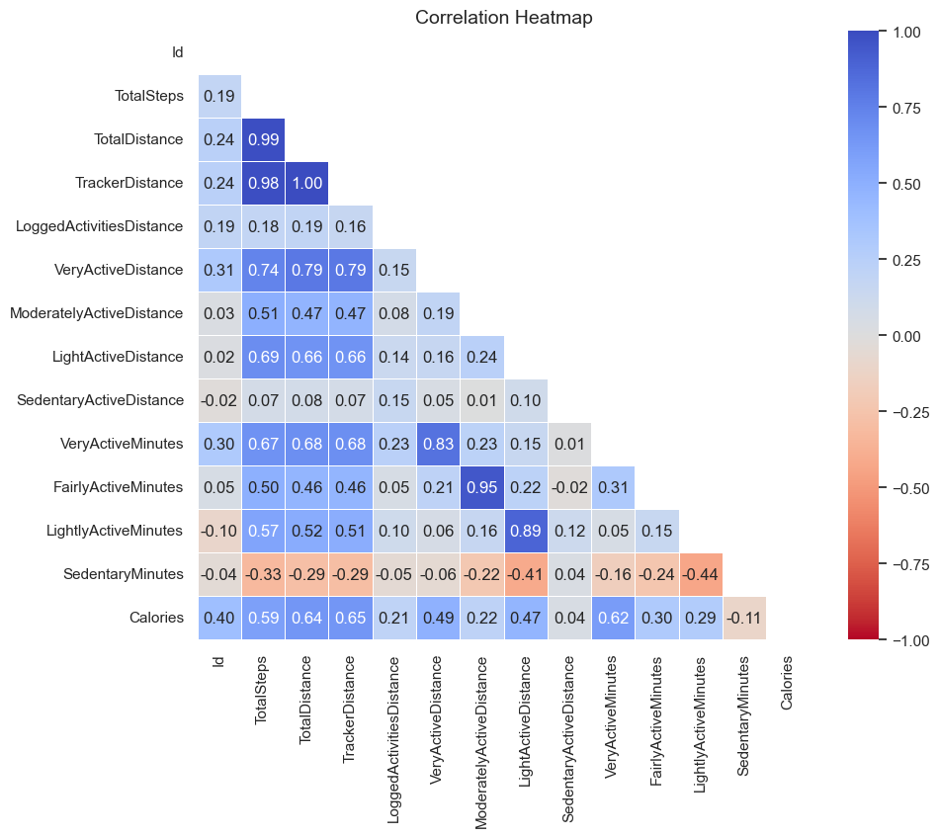
Workflow: Correlation Analysis
Feature Correlation
Identify relationships between variables
User Behavior Insights
Understand how users interact with their devices

Slide 7
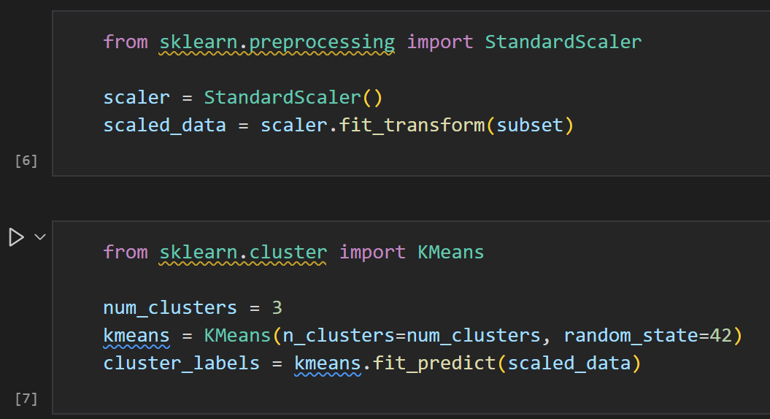
Workflow: Clustering
Data Scaling
Prepare data for clustering using StandardScaler.
K-Means Clustering
Group users into 3 clusters based on behavior.

Slide 8
Key Health Insights
Majority of users are only lightly active.
Average Sleep: Participants average 7 hours of sleep per night.
Average Steps: 7,638 steps/day, slightly below the recommended 8,000 steps for significant health benefits.
Very Active Minutes: Mean of 21 minutes/day. Room to encourage more high-intensity workouts.
Sedentary Time: Participants are sedentary for about 16.5 hours/day, common in industrialized countries. Increases risks of obesity and heart disease.
Action: Promote increased physical activity to combat health risks.
Caloric Burn: Average daily calorie burn is 2,304 calories.
Weight & BMI: Average weight is 72 kg, with a mean BMI of 25.18, which is rather high, highlighting the importance of maintaining a healthy lifestyle.

Slide 9
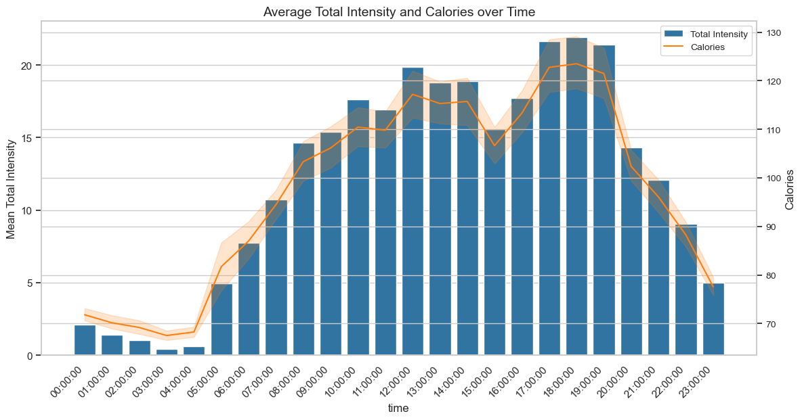
Activity and Calorie Patterns Throughout the Day
Activity Peaks: Most activity happens between 5 am and 11 pm, with peaks around 5 pm and 7 pm.
Insight: Indicates post-work gym or other activities.
Correlation: Intensity and calorie burn are closely related.
Recommendation: Sending notifications to promote physical activity during peak times can motivate people.

Slide 10
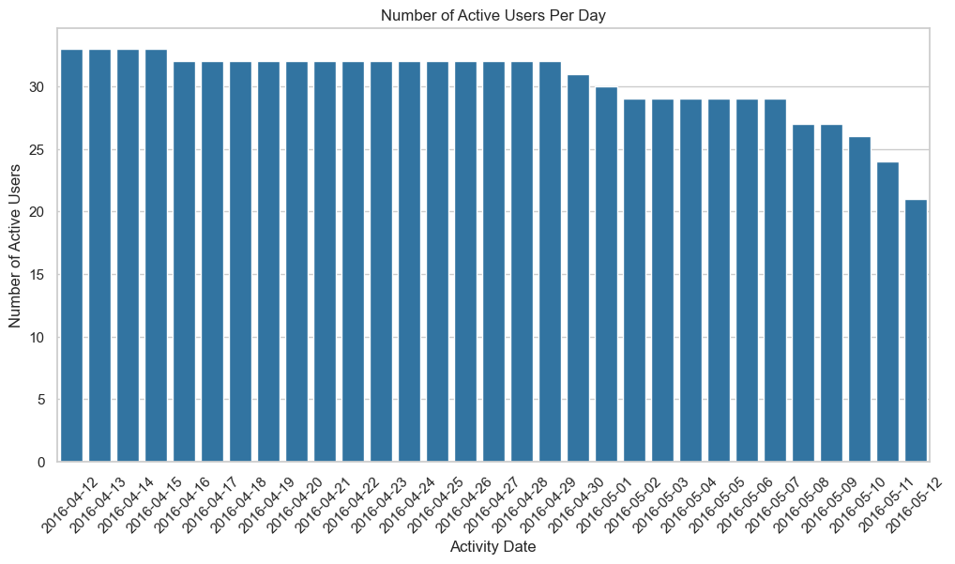
Active User Trends Over Time
Initial Usage: All 33 users used the app daily at the beginning of data collection.
Decline Over Time: Usage steadily decreased over the data collection period.
Recommendation: Motivating users through streaks and ranking systems can enhance engagement.

Slide 11
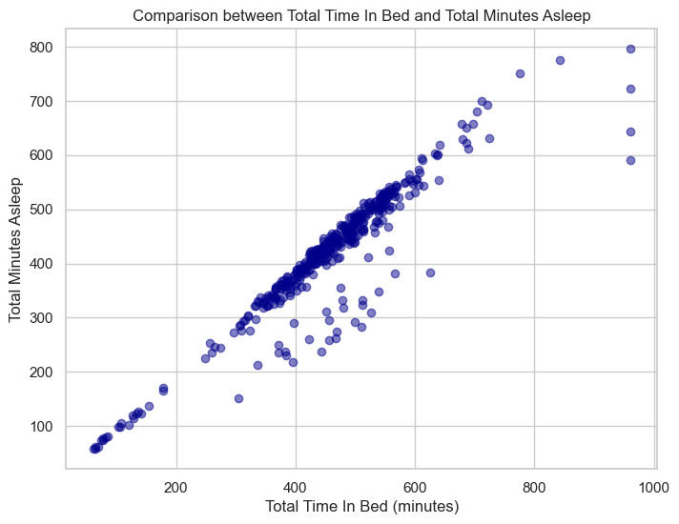
Correlation Between Time in Bed and Time Asleep
Correlation: Clear correlation between time spent in bed and total minutes asleep.
Outliers: Some outliers suggest bed usage without actual sleep.
Recommendation: Encourage bed use solely for sleep to enhance sleep quality and improve sleep patterns.
Action: Designate the bed exclusively for sleep, considering the right environment and habits.

Slide 12
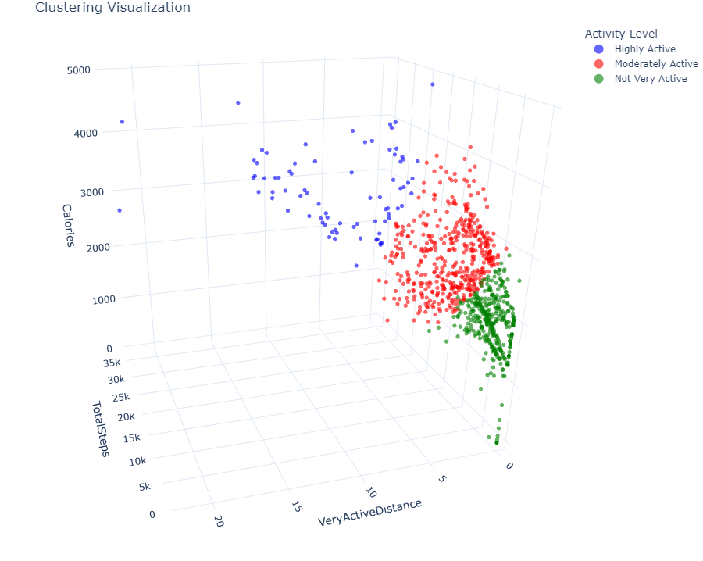
K-Means Clustering Approach
Clustering users based on three features:
Total Steps
Very Active Distance
Calories
Purpose:
Assign users to three groups:
Highly Active
Moderately Active
Not Very Active
Provide personalized recommendations based on group

Slide 13
Key Insights and Actions
Promote Physical Activity:
Send notifications in the early evening to encourage activity.
Enhance Engagement:
Motivate users with streaks and ranking systems.
Improve Sleep Quality:
Encourage bed use solely for sleep.
Personalized Recommendations:
Use clustering to assign users to groups and tailor recommendations.
Increase Data Diversity:
Collect more data from female users for better insights.

